Slide 1
UX Example: A website for Southwest Coder Dojo
Madeleine Lowry
Solo Project (2 weeks)
Prime Digital Academy
September 2015

Slide 2
Objective
Southwest Coder Dojo is a member of Coder Dojo International, a worldwide association of computer programming clubs for kids.
It was founded by Madeleine Lowry, a Southwest HS parent, in partnership with Southwest High School Community Education to provide introductory coding experiences for teens in the Southwest Minneapolis area.
A website presence was needed to provide a single place for interested individuals to view events and coordinate registration activities. Additionally, it would be a source of information for volunteer mentors to learn about the program.
Other needs included: collecting participant email contact info, a reference list of online coding resources and links to local organizations that provide access to free laptops.
This was a 2-week student project during Prime Academy’s Computer Programming Bootcamp.

Slide 3
More Objectives
As a site for teens, it had to be teen-friendly
It was important to feature girls and minorities prominently
Make it clear that events were open to the public, not just Southwest High School students

Slide 4
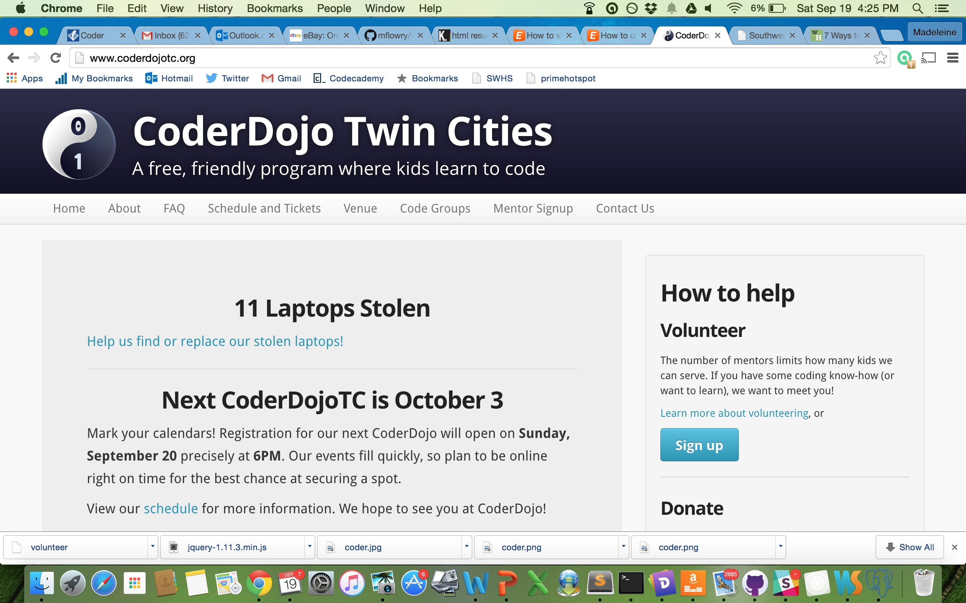
Missteps
Initially I intended to follow the model of the Twin Cities Coder Dojo, which has the traditional flow of an informational website.

Slide 5
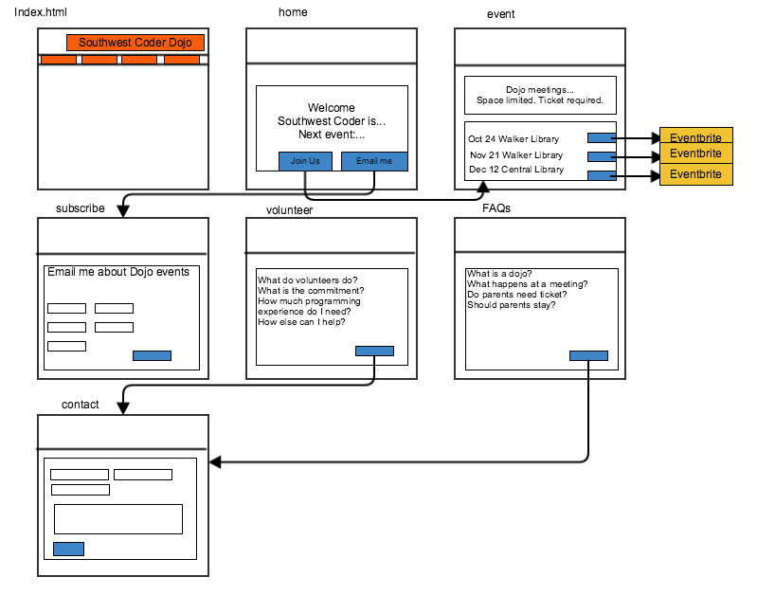
Wireframes
I started to draft wireframes using Gliffy: home page, event page, FAQ page, etc.

Slide 6
Oh! User Experience
Next, we had our first lecture on UX methods.
I realized that before I started developing the site, I needed to talk to potential users!
This site was intended for teens. I needed to learn how teens thought and how they wanted to receive information. I wanted to know what kind of visual designs would appeal to them.

Slide 7
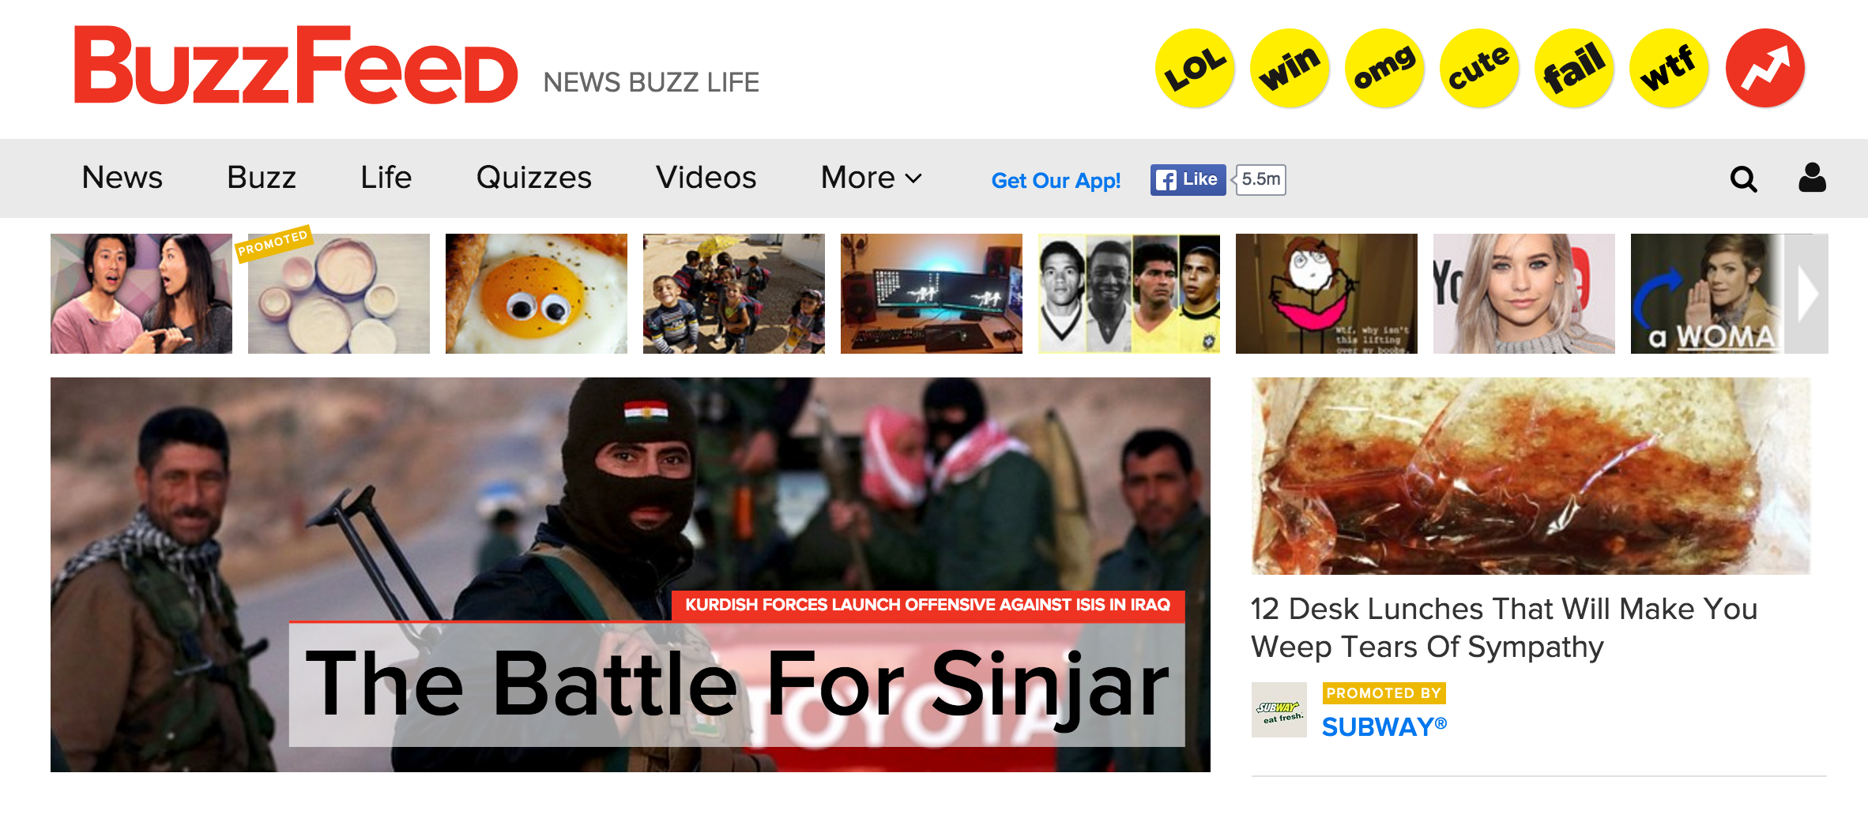
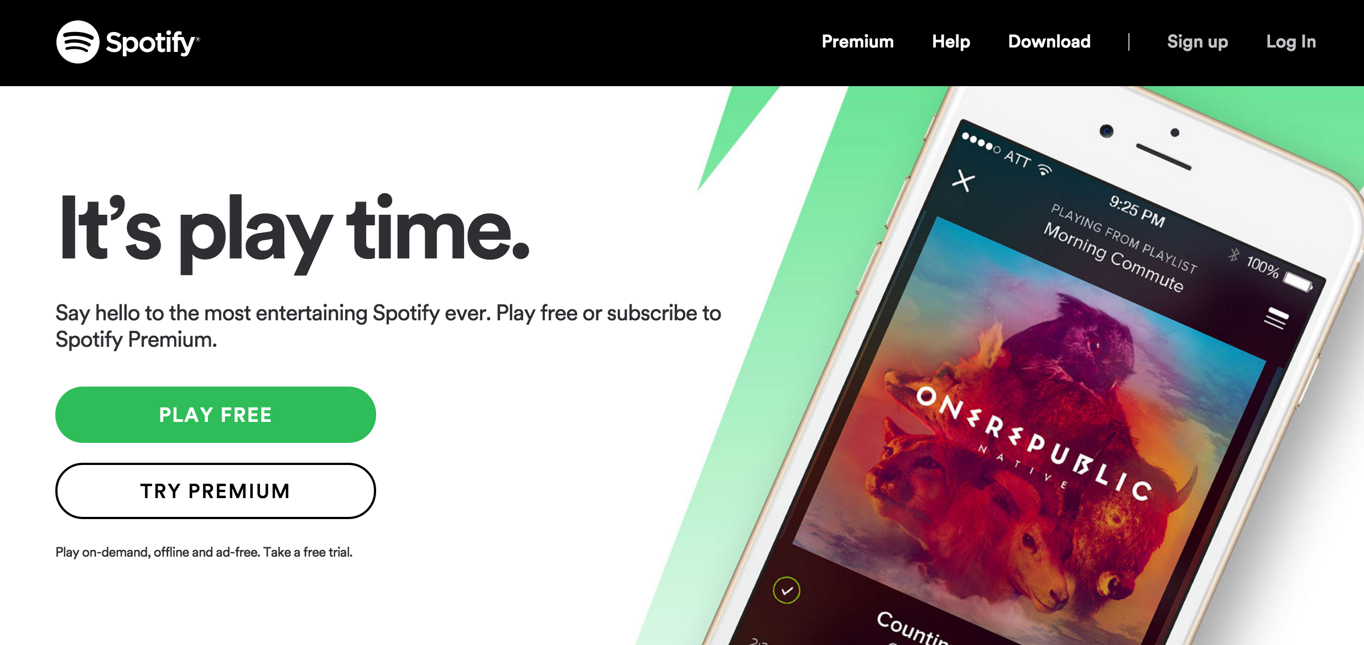
User Persona
Russ (16, high school sophomore)
Russ has messed around with computers and digital devices all his life. He’s curious about computer programming and likes the idea of building mobile apps.
Favorite sites include:

Slide 8
User Interview
A teen user was asked to review the existing site for Twin Cities Coder Dojo, a similar organization
He provided feedback on
Overall impressions
Home page
Registration process
Site Design

Slide 9
User Interview: Overall Impressions
Flow is not clear; navigation is too complicated. (Clicking through all the links.) “I’d be outta here and looking for another dojo.”
“This is really a website for people who already know what it [a coder dojo] is.” “This is for people who have already done this before, not for new people.”
“This is a website for parents to sign up their kids, not for teens to sign themselves up.”
“It says it’s for kids age 8 – 17, but all the photos are of school age kids.” “Feels like an elementary school program. “(About Us Page)
“They use the word “cool” in trying to be kid-friendly.” (And it’s not working…) (About Us page)
“These FAQs are not too helpful.” Geared to parents, not participants.
“What is this ying-yang symbol about?” (logo)

Slide 10
User Interview: Home Page
“This is a weird front page.”
“Don’t put “laptops stolen” as the first thing. Makes me feel like my laptop might be stolen.”
“I don’t want to take the time to watch this video unless I feel like I’m sure I want to sign up.” (Until I know that Coder Dojo is for me…)
“On the first page I want to know what Coder Dojo is about, when the next meeting is and what club meetings are like. I want FAQs underneath in a long scroll.”
“You need tickets?! Are they free?”
“Doesn’t tell me how much [coding] experience is needed.”
“What is a meeting like?” “How many people are there?” “What do you learn?” “How long does it last?”

Slide 11
User Interview: Registration Process
“Not clear what code groups are. Is this the same thing as the dojo?”
Click “how to register” => doesn’t do anything. (Frustrating.) The link goes to another page –can’t sign up—have to wait for an email announcing tickets. (Code Groups Page)

Slide 12
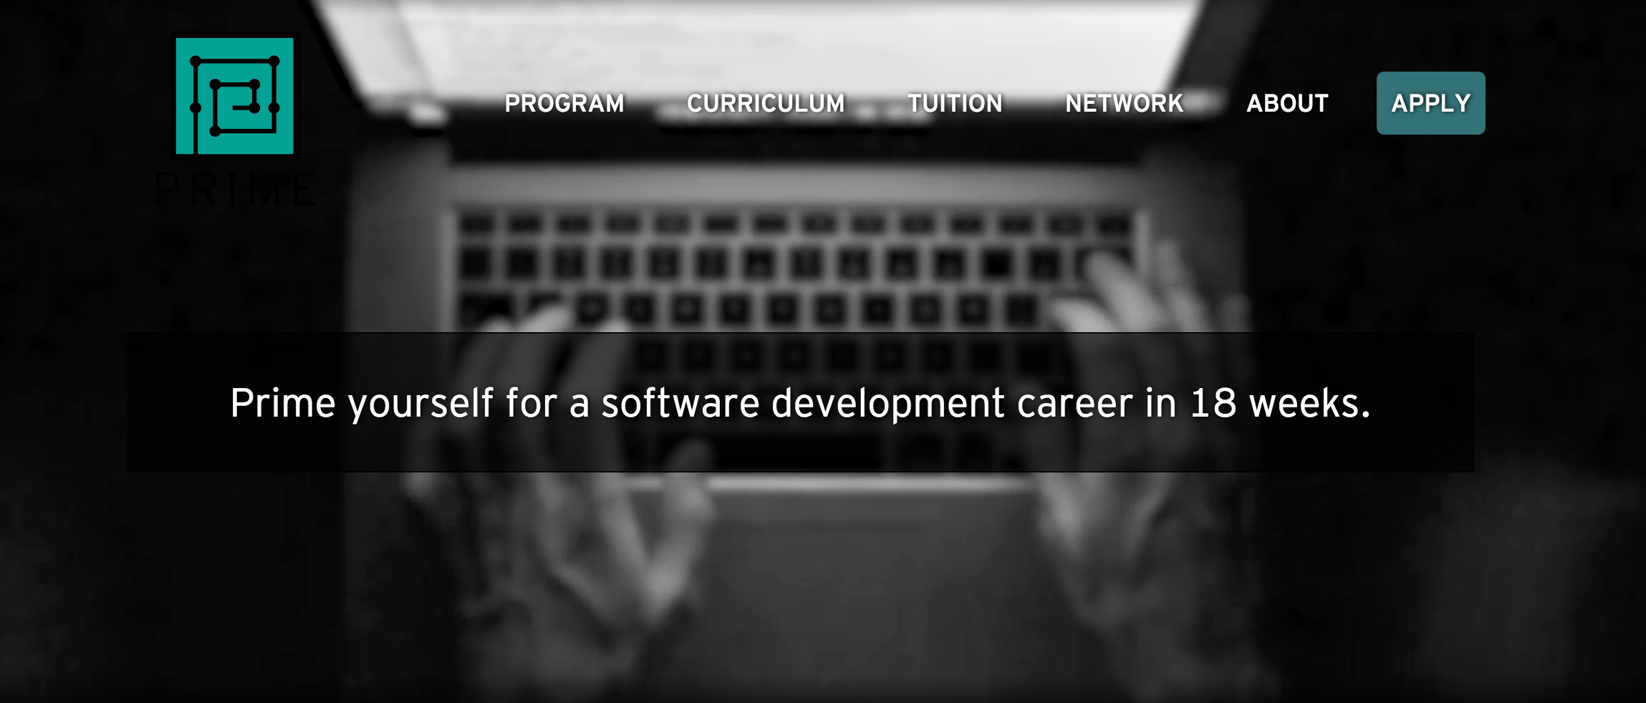
User Interview: Site Design
When shown a different website illustrating a long-scroll navigation approach, the user offered the following feedback.
This is a good website!
I like that animation in the background
I like the long format and the content sections that are broken out by color
The color scheme is good – just black, white, gray and an accent color.

Slide 13
Re-framing the Site Design
As a result of the User Interview, I understood exactly what I needed to build, what information was important and the order it should be delivered in.
I re-framed the Content and Design Objectives:
Content Objectives:
Clear simple navigation
Copy written for a novice user (i.e., someone who has never heard of a Coder Dojo before)
Address teens, not their parents
Link to registration page from the site
Design Objectives:
Long-scroll format with navigation that takes you to different content areas on the page
Color scheme that includes a bright accent color
Modern clean aesthetic
Photos of teens, not kids

Slide 14
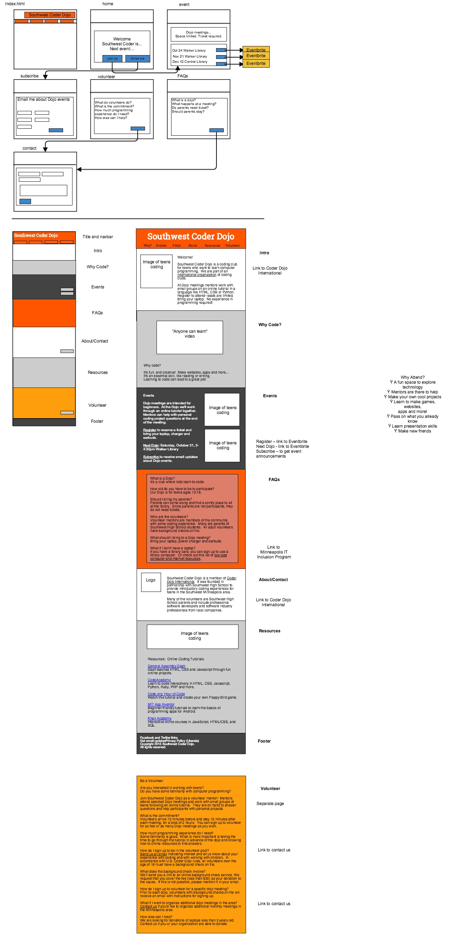

New Wireframes
I created new wireframes for a long-scroll format.
I selected photos and other visual assets that featured teens.

Slide 15
User Review of Prototype
After an initial round of development, two teens were asked to review the prototype website and they gave the following feedback:
First photo looks posed, but the other two look like real teens.
Color scheme – change the orange and brown; prefer Coder Dojo International website’s colors
The site is visually appealing, especially:
Clean layout
Long scroll with different sections of color
What do you do at a Dojo meeting? Which language will you teach?
Say that it’s for people with no coding experience. “Beginner” sounds like you ought to have at least some experience

Slide 16
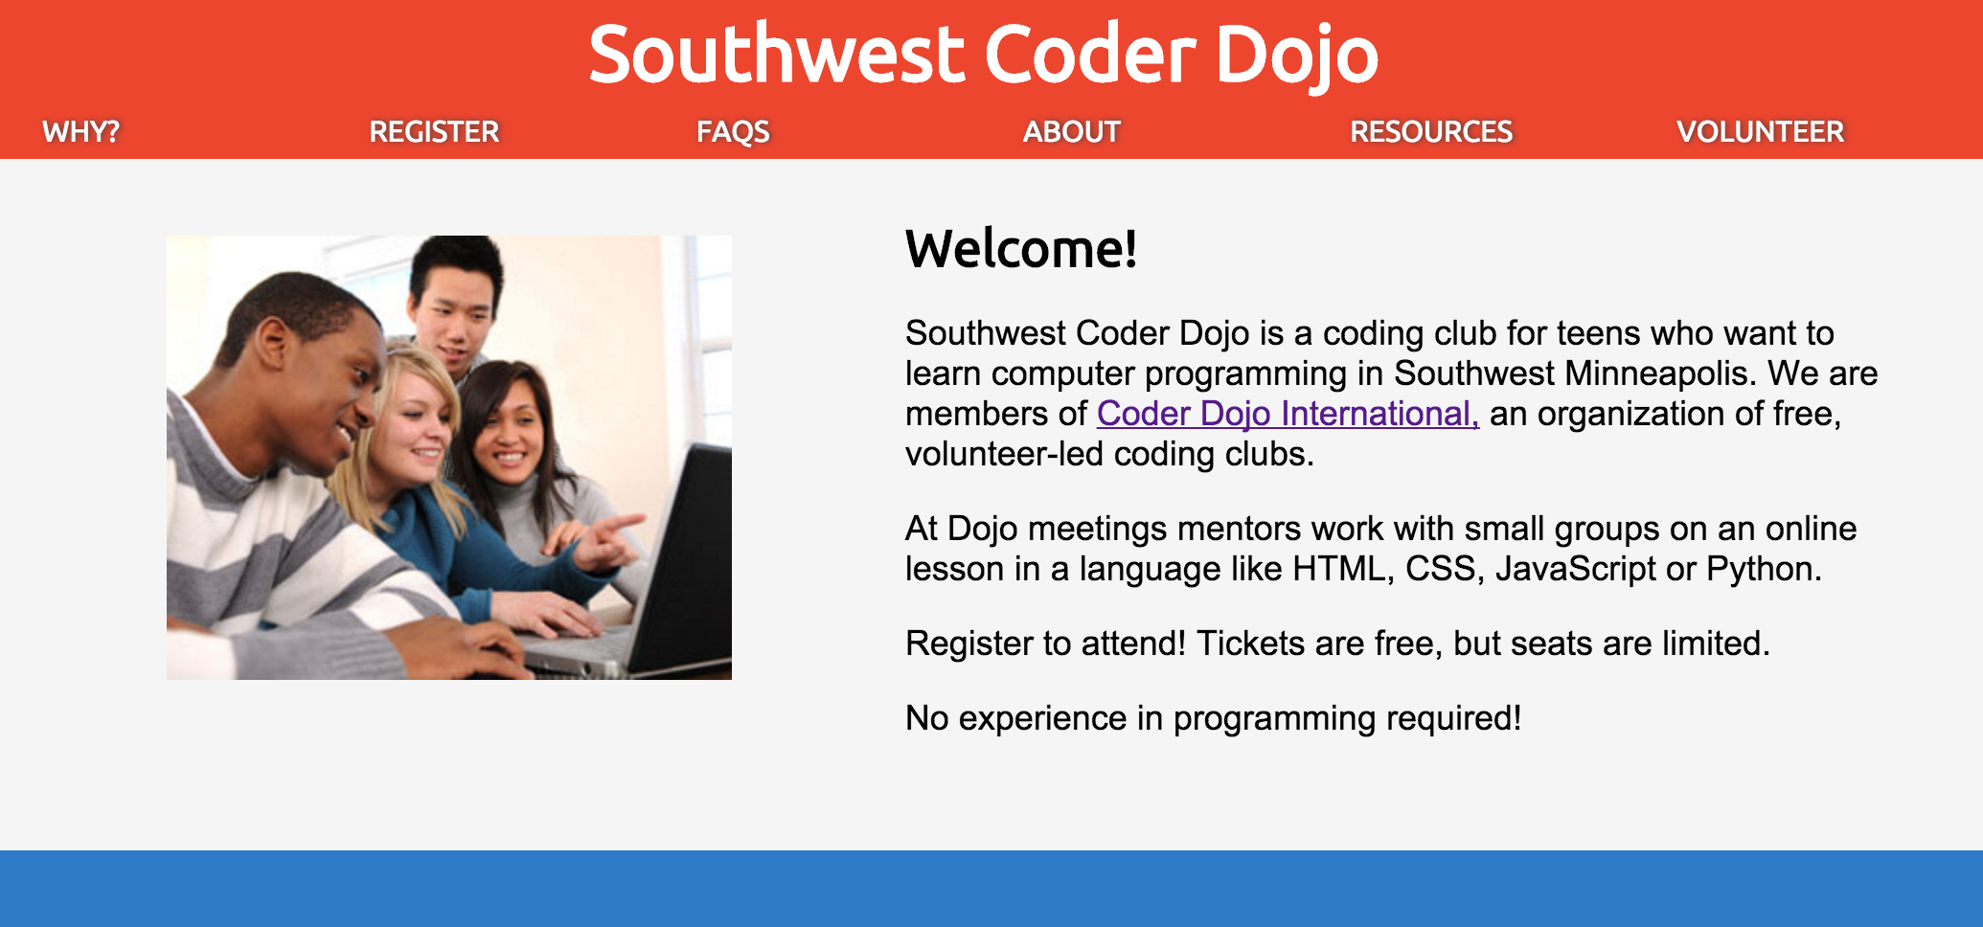
Finished!
After incorporating their suggested changes, I had a final version of the website.
This was a 2-week solo project including scope definition, wireframing, development, testing and deployment. I was the only student that incorporated a UX process.

